Slide 1



EFFICIENT PAIR SUM DETECTION USING SORTING AND TWO-POINTER TECHNIQUE
22ITT31 - Design & Analysis of Algorithm
Presented By :
PRANESH R
23ITR118
B.Tech IT - B

Slide 2
Problem Statement
You are given an array A of n real numbers and a real number s. Your task is to determine whether there exist two distinct elements in the array whose sum equals s.
Design an algorithm that solves this problem with better than quadratic time complexity (i.e., better than O(n²)).

Slide 3
Objectives
Understand the problem of finding two elements in an array that sum to a target value s
Design an efficient algorithm using presorting and two-pointer technique
Improve performance from brute-force O(n²) to O(n log n) or O(n)
Demonstrate the algorithm with step-by-step explanation and example
Analyze time and space complexity of the proposed solution.
3

Slide 4
Assumption
The array A contains real numbers (can be positive, negative, or zero)
The target sum s is a real number
Array size n is reasonably large (e.g., up to 10⁶), so efficiency matters
Elements in the array are not necessarily sorted
It is required to find two distinct elements whose sum equals s
No duplicate pairings are needed (i.e., once a pair is found, the search can stop)
4

Slide 5
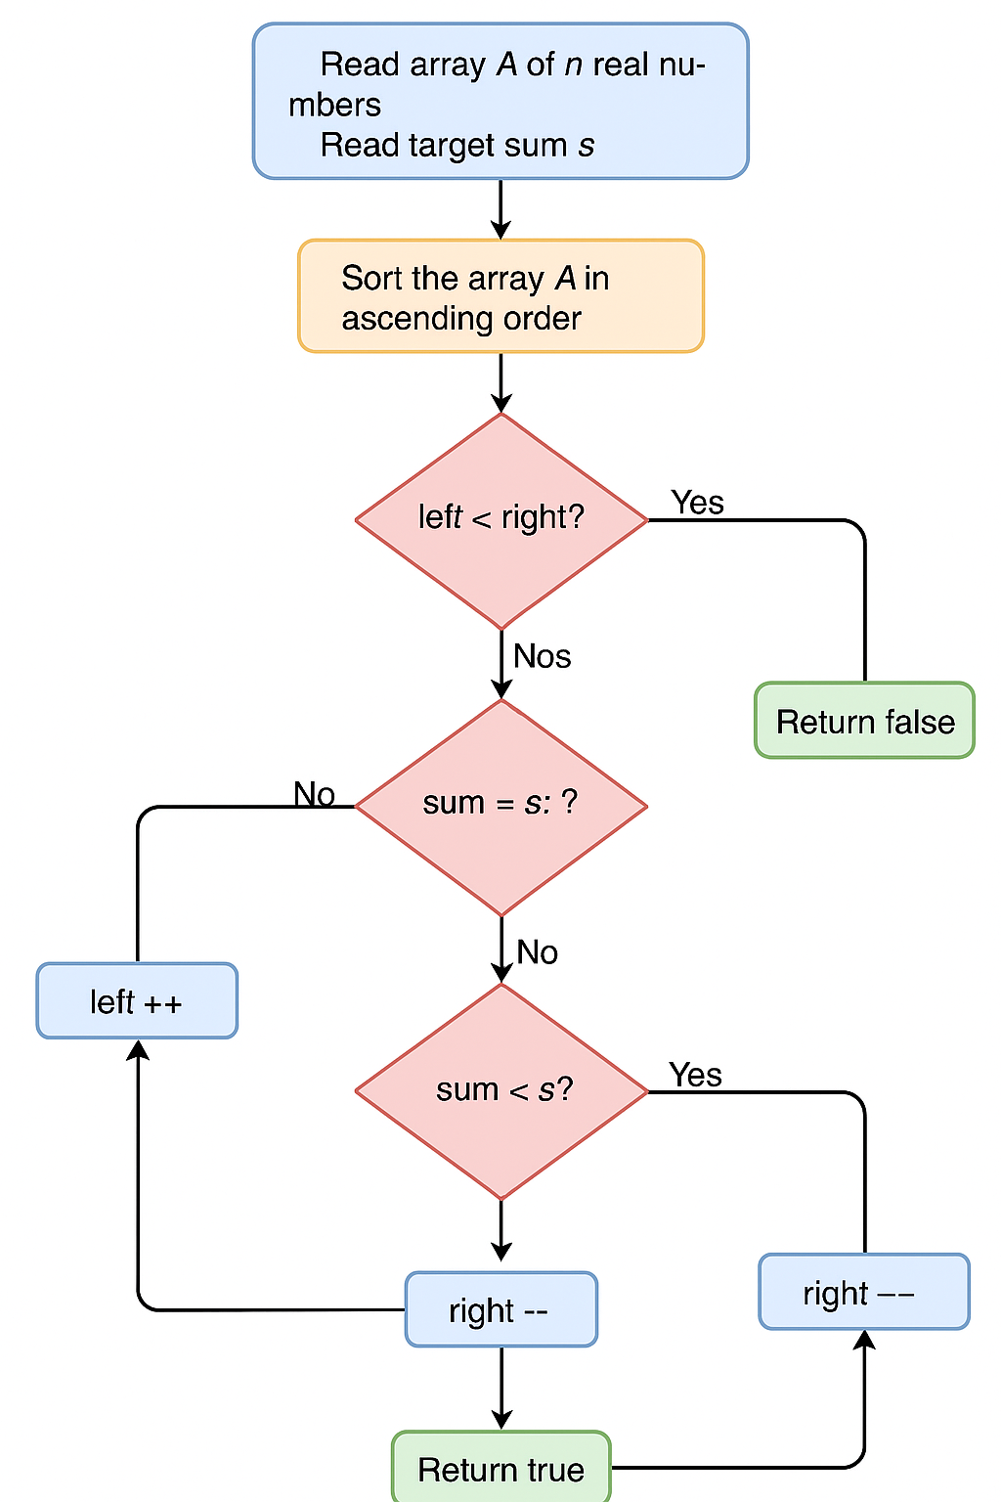
Flowchart
5

Slide 6
Algorithm
Algorithm FindPairWithSum(A[0...n-1], s):
1. Sort the array A in ascending order // Time: O(n log n)
2. Initialize two pointers:
left ← 0
right ← n - 1
3. While left < right:
sum ← A[left] + A[right]
If sum == s:
Return true // Pair found
Else if sum < s:
left ← left + 1
Else:
right ← right - 1
4. Return false // No such pair exists
6

Slide 7
Pseudocode
Function FindPairSum(A, s):
Sort A in ascending order
left ← 0
right ← length(A) - 1
While left < right do:
sum ← A[left] + A[right]
If sum = s then:
Return True // Pair found
Else if sum < s then:
left ← left + 1
Else:
right ← right - 1
Return False // No pair found
7

Slide 8
CODING
def find_two_sum_presort(arr, target_sum):
sorted_arr = sorted(arr)
left = 0
right = len(sorted_arr) - 1
while left < right:
current_sum = sorted_arr[left] + sorted_arr[right]
if current_sum == target_sum:
return True, (sorted_arr[left], sorted_arr[right])
elif current_sum < target_sum:
left += 1
else:
right -= 1
return False, None
if __name__ == "__main__":
try:
print("Enter the array elements (space-separated numbers):")
arr_input = input().strip()
arr = [float(x) for x in arr_input.split()]
print("Enter the target sum:")
target_sum = float(input().strip())
found, pair = find_two_sum_presort(arr, target_sum)
print("\nResults:")
print(f"Array: {arr}")
print(f"Target sum: {target_sum}")
if found:
print(f"Found pair: {pair[0]} + {pair[1]} = {target_sum}")
else:
print("No pair found that sums to target")
except ValueError:
print("Error: Please enter valid numbers")
except Exception as e:
print(f"An error occurred: {str(e)}")

Slide 9
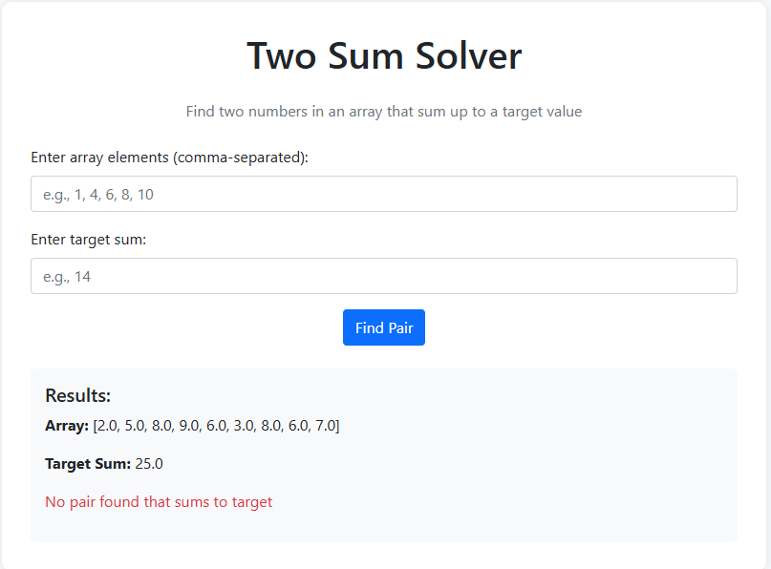

Slide 10
Thank you!

